Slide 1
A signaling theory of acquisition premiums: Evidence from IPO targets
Jeffrey Reuer, Tony W. Tong, & Cheng-wei Wu
Academy of Management Journal (2012)
Presented by Jingya You

Slide 2
INTRODUCTION
Acquisitions of IPO firms are subject to information asymmetries
Target’s core resources and prospects are difficult for buyers to understand and value
Target’s short track records or lack of credibility in other markets can compound such challenges
IPO targets will capture less value in acquisitions if buyers discount their offer prices
Research question: What particular signals about IPO firms will have an impact on the premiums they obtain when selling their companies?

Slide 3
THEORETICAL BACKGROUND
Determinants of acquisition premiums
The total value creation potential of acquisitions
Macroeconomic factors (e.g., business cycles; overall supply and demand conditions in the M&A market)
Managerial biases and organizational learning
Gap: they have devoted less attention to the role of target firms
Finance research on target firm considerations has emphasized the implications of agency costs, such as how management resistance to acquisitions affects acquisition premiums.
Complement prior studies by joining them with signaling theory and by focusing on target-side determinants of acquisition premiums.

Slide 4
SIGNALING THEORY
Spence (1974) and other studies in information economics have examined the implications of asymmetric information and adverse selection in various markets.
Spence (1974) focuses on the process of hiring of employees
The most productive recruits will not be offered higher wages, if employers cannot efficiently ascertain productivity
Although productive employees might want to reveal productivity information, they encounter credibility problems
As a result, educational achievement can be a valuable signal
Studies in other market settings suggest that the presence of signals or other remedial mechanisms can promote exchanges and reduce offer price discounting (e.g., Akerlof, 1970).

Slide 5
HYPOTHESES
Signals can be useful to help a seller to obtain a higher acquisition premium
If an IPO target can rely on signals, an acquirer is more likely to proceed with a deal
A potential acquirer is less likely to discount its offer price because the presence of signals reduces the uncertainty bidders face about the potential value of the target
Focus on three types of interorganizational relationships
Prominent underwriters
Venture capitalists
Alliance partners

Slide 6
HYPOTHESES (Main Effects)
Investment bank reputation
Two-sided matching: higher-quality firms have an interest in associating with the most prominent investment banks and vice versa
Venture capitalist prominence
VCs carry out evaluations over time and make follow-on investments in stages
Extensive information channels enable VCs to obtain proprietary information about the ventures
Strategic alliances
Alliances are widely observable and reflect the extent to which a firm’s resources and capabilities are in demand by other organizations
The acquisition premium received by an IPO target is positively related to the reputation of its investment bank (H1), relationships with prominent VCs (H2), and the number of alliances it has formed with prominent partners (H3).

Slide 7
HYPOTHESES (Contingent Effects)
The value of signals depends on the level of information asymmetry faced by an individual acquirer
The relatedness of the acquirer and target
Given the greater risk of adverse selection that exists when acquirers and targets operate in industries with different knowledge requirements, it is expected that signals will be especially valuable for such acquisitions
Cross-border acquisition
Compared to domestic acquisitions, deals between foreign acquirers and domestic targets involve more information asymmetry problems
Differences in national institutional environments increase the information asymmetry between firms situated in different countries

Slide 8
HYPOTHESES
Signals
Investment bank reputation (H1)
Venture capitalist prominence (H2)
Alliance partner prominence (H3)
Acquisition premium
+
+
Knowledge distance (H4)
Cross-border acquisition (H5)

Slide 9
METHODS
Data sources: SDC database, Compustat, and CRSP
Sample: 308 deals involving 263 acquirers during 1991-2000
Measurement
DV: Acquisition premium – percentage difference between a purchase price and IPO target’s value four weeks prior the announcement of the acquisition
IVs
Investment bank reputation – the ranking of the lead underwriter for each IPO
Venture capitalist prominence – dummy variable. A VC firm is prominent if the number of IPOs backed by the VC was above the median, 0 otherwise
Prominent alliance partners – the number of firms’ partners that were publicly listed
Moderators
Knowledge distance – calculated based on the proportions of employees in certain occupations
Cross-border acquisition – dummy variable
Controls
IPO targets: firm size, Tobin’s Q, IPO underpricing, analyst coverage, time since IPO, managerial ownership, inside directors, and blockholdings
Acquirer’s characteristic: M&A experience
Transaction characteristics: deal size, tender offer, stock offer, percent acquired, and competing bidders
Others: high-tech industry dummy, industry fixed effects, year fixed effects

Slide 10
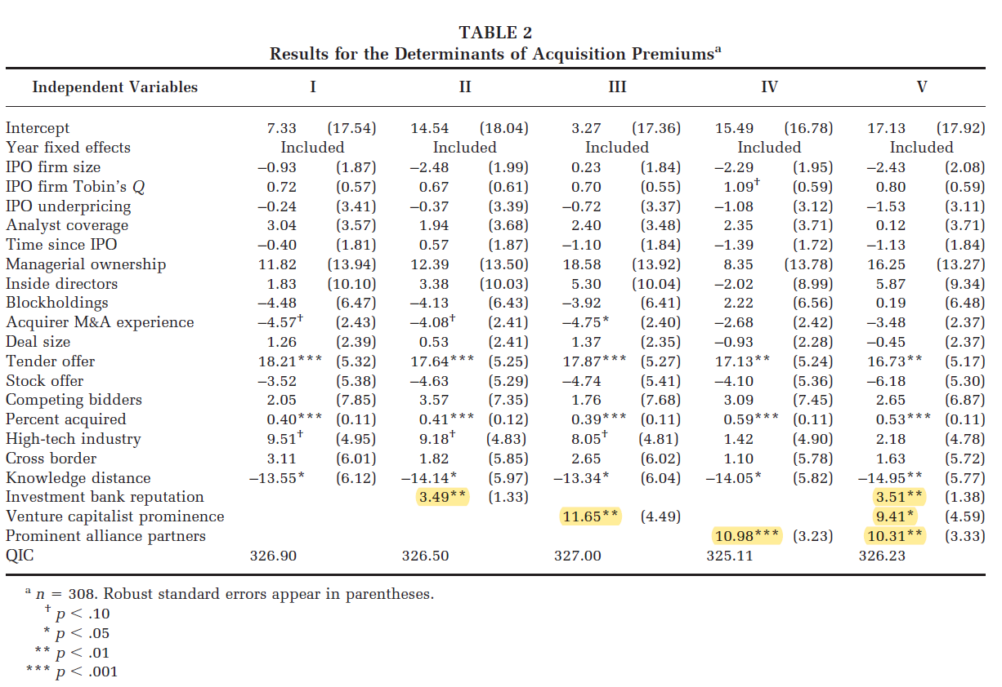
RESULTS
H1
H2
H3

Slide 11
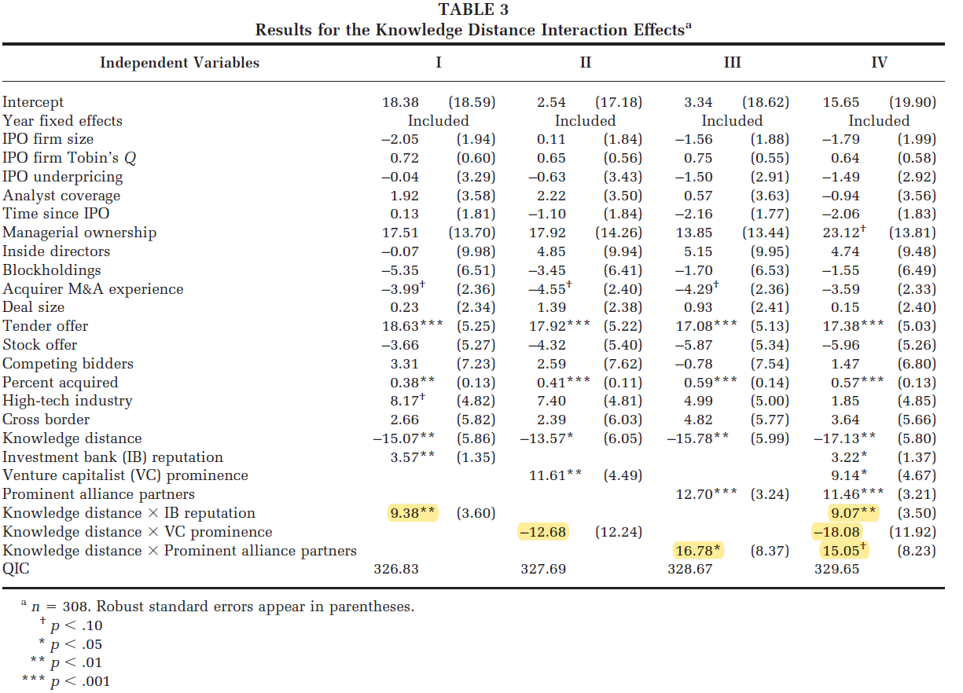
RESULTS
H4a
H4b
H4c

Slide 12
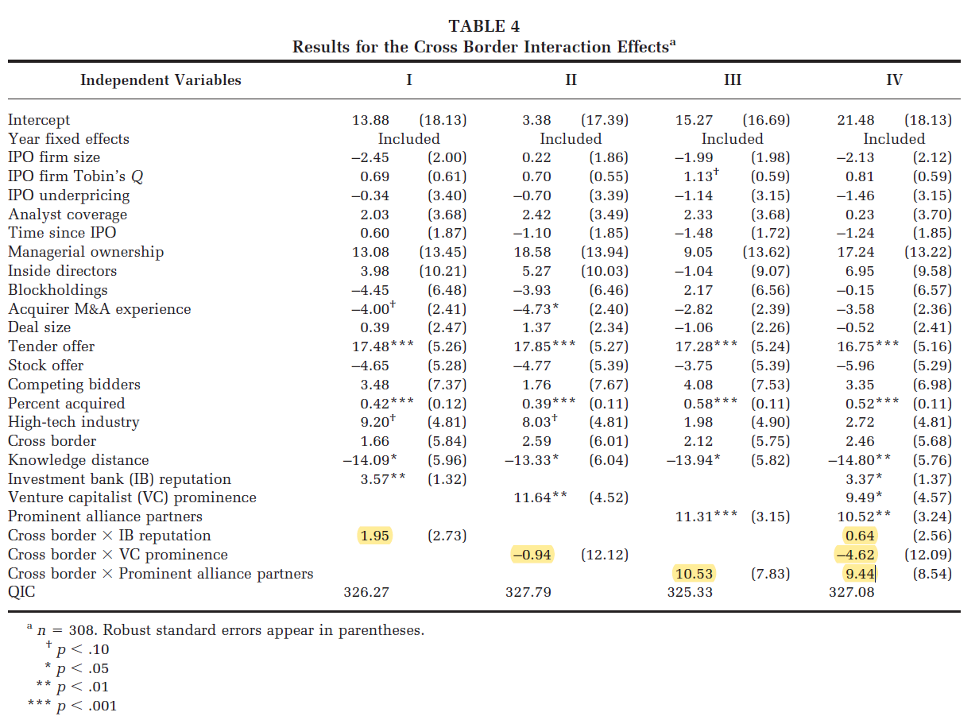
RESULTS
H5a
H5b
H5c

Slide 13
CONCLUSIONS
The signals conveyed by firms’ interorganizational relationships (i.e., prominent underwriters, venture capitalists, and alliance partners) can enhance the gains IPO firms obtain when selling their companies.
The benefits of such signals apply similarly to domestic and cross-border acquisitions, and these benefits are more pronounced when IPO firms sell their companies to acquirers based in different industries.
This study advances M&A research by developing a signaling theory of acquisition premiums. Additionally, it also responds to calls for research on sell-side considerations in acquisitions research.

Slide 14
DISCUSSION
This article introduces signals derived from three different types of interorganizational relationships. Do these signals complement or substitute for each other?
To what extent do acquirers rely on and act on a target’s signals? What factors may influence the extent to which acquirers depend on a target’s signals? For example, target-specific experience developed from prior collaborations may reduce the value of signals by directly mitigating an acquirer’s risk of adverse selection.

